Slide 1


Geometric Analysis Based Algorithms for Effective Representation and Detection of Curves with Application to Tracking Moving Dim Target
Advisor: Dr. Ofer Levi
By: Galit Volpert

Slide 2
Presentation Outline
Motivation
Objectives
Background
SHAS vs other X-ray approaches
Dynamic SHAS
Dim Target tracking application
Experiments methodology
Results

Slide 3
Motivation
Multiscale Geometric Analysis
Detect, organize, represent, and manipulate
data
which nominally span a high-dimensional space
but
which contain important features
which are approximately concentrated on lower-dimensional subsets (curves, sheets, etc.).
http://www.ipam.ucla.edu/programs/long-programs/multiscale-geometry-and-analysis-in-high-dimensions/
Notes:
Works done in the scientific area that deals with…..

Slide 4
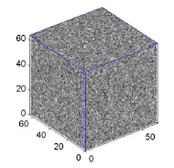
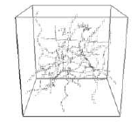
Motivation
Data of Interest
n³ – voxels (cube), f(x,y,z)
-point field
Contains filaments and noise
Notes:
אלמנטים חוטים

Slide 5
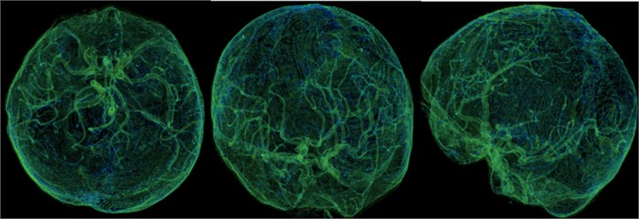
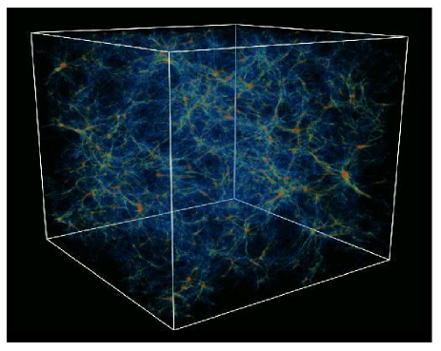
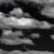
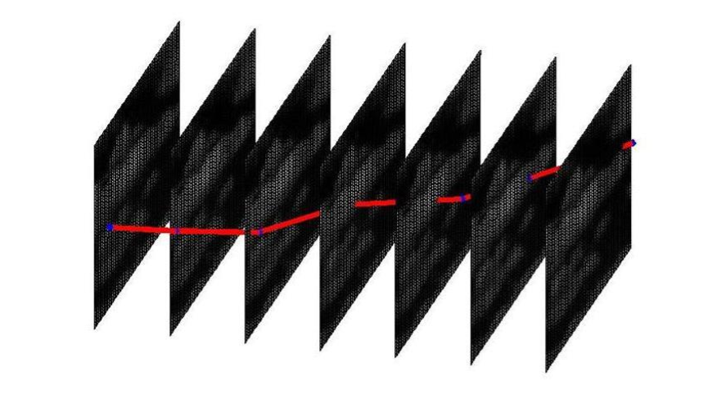
Motivation
Applications
Medical and Biological Imaging
Astronomy
Dim Moving Objects Tracking
Mehul P. Sampat, Alan C., Bovik B., Mia K. Markey, Classification of mammographic lesions into BI-RADS shape categories using the Beamlet Transform
https://www.jvejournals.com/article/20724
D. L. Donoho a, O. Levi a, J.-L. Starck b and V.J.Mart´ınez c ,Multiscale Geometric Analysis for 3-D Catalogues
https://www.pinterest.com/pin/490540584389823063/

Slide 6
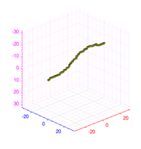
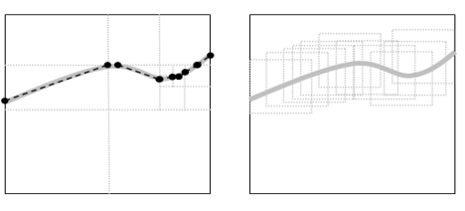
Motivation
Dim Moving Objects Tracking
Man-made dim moving target.
A point target.
Low SNR (barely seen by naked eye).
Multiscale
Dynamic - Mono-scale
?
Notes:
Our interest is in the detection of a sub-pixel target, which is significantly smaller than pixel size, where there is no need to take into account the target point spread function, which is assumed to have its entire support inside a single pixel.
Multiscale based algorithm – develop by Boris Efrati in its thesis
Dynamic Mono-scale based algorithm – this thesis

Slide 7
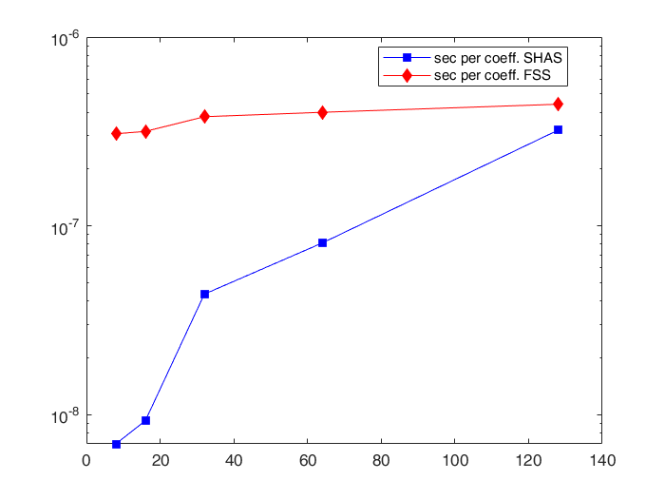
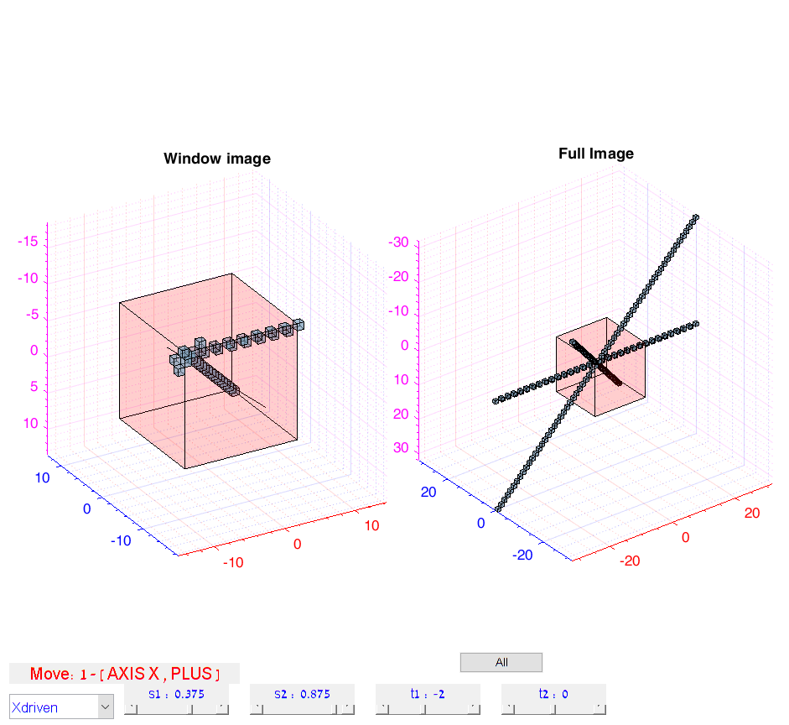
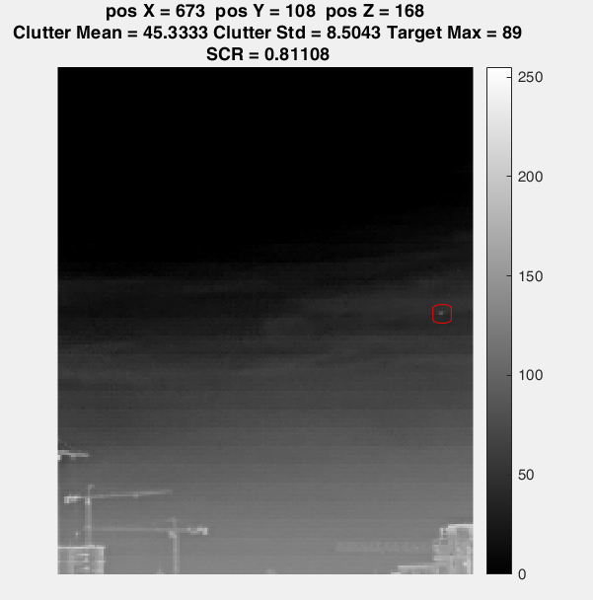
Objective
Validate the accuracy and efficiency of the Geometric approach X-ray transform algorithm named SHAS by comparing to other discrete X-Ray transform algorithm \
Analyze and present the Dynamic SHAS as a computationally efficient algorithm for dynamically computing X-Ray coefficients inside a sliding window.
Develop a Dynamic SHAS based tool for tracking a dim target.

Slide 8
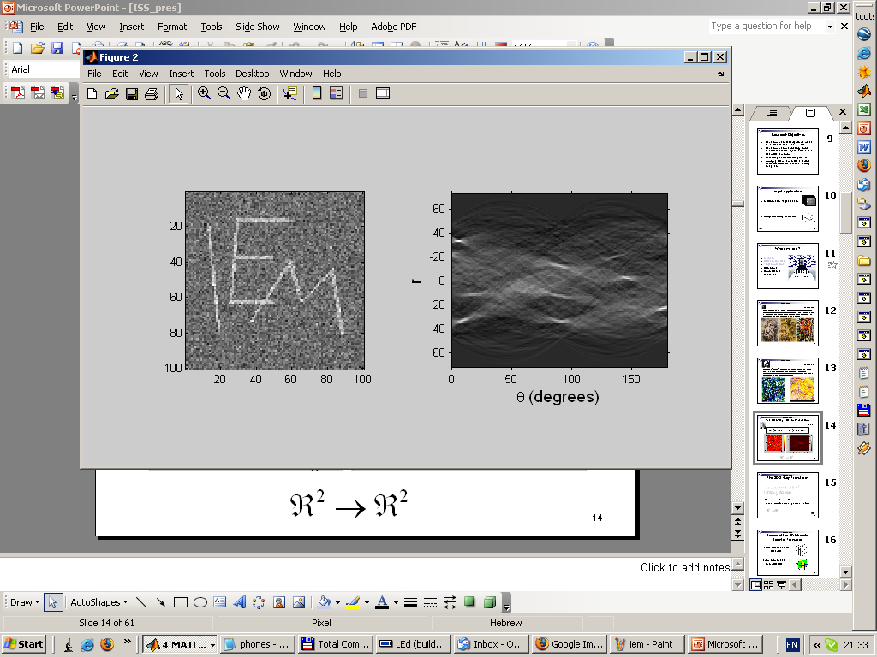
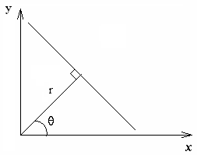
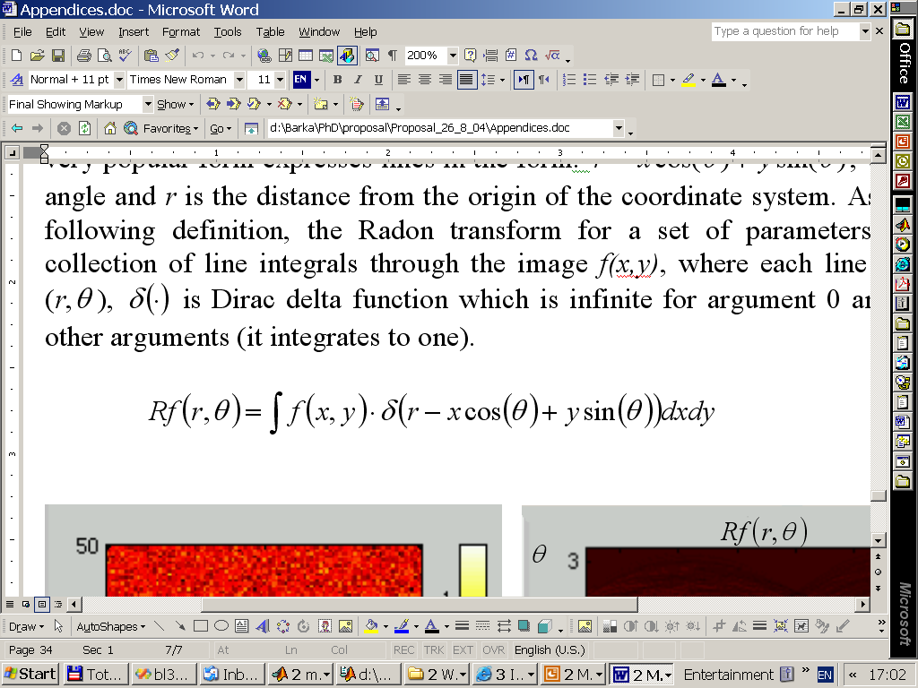
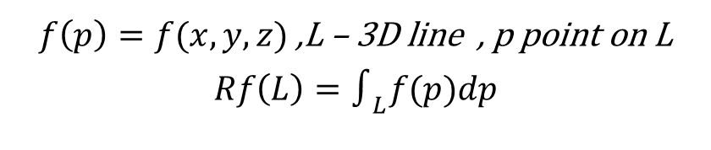
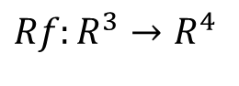
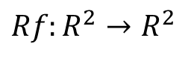
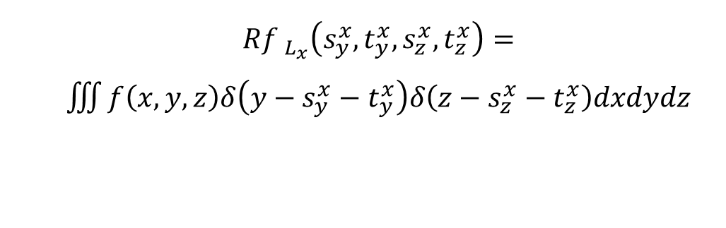
Background
X-Ray Transform
An integral transform mapping spatial data into the parametric space of line integrals
2D 3D
$f\left(p\right)=f(x,y,z)$ ,L – 3D line , p point on L
$$Rf\left(L\right)=∫_{L}f(p)dp$$
$${Rf }_{L_{x}}\left(s_{y}^{x},t_{y}^{x},s_{z}^{x},t_{z}^{x}\right)=$$
$\iiint{f\left(x,y,z\right)δ\left(y−s_{y}^{x}−t_{y}^{x}\right)δ\left(z−s_{z}^{x}−t_{z}^{x}\right)dxdydz}$
$${Rf:R}^{2}→R^{2}$$
$${Rf:R}^{3}→R^{4}$$
Notes:
$\text{point} \text{and} \text{unit} \text{vector} R^{6}→R^{4}$

Slide 9
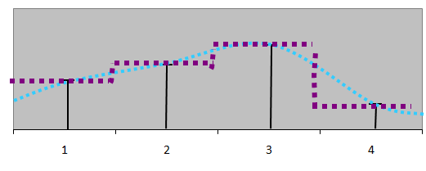
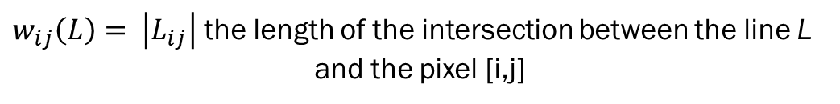
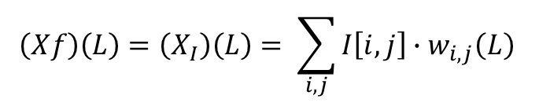
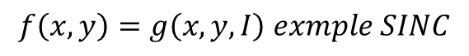
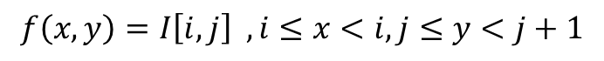
Background
Discrete X-ray transform
Interpolation Scheme
0
9
1
9
10
5
3
10
6
8
10
3
9
3
8
4
Piecewise constant interpolation – interpolation of order zero
“smooth” interpolation – interpolation of higher orders
$$f\left(x,y\right)=I\left[i,j\right] ,i≤x<i,j≤y<j+1$$
$$f\left(x,y\right)=g\left(x,y,I\right) exmple SINC$$
$$\left(Xf\right)\left(L\right)=\left(X_{I}\right)\left(L\right)= \sum_{i,j}{I\left[i,j\right]∙w_{i,j}\left(L\right) }$$
$w_{ij}\left(L\right)= \left|L_{ij}\right|$ the length of the intersection between the line L
and the pixel [i,j]
Notes:
The X-Ray transform is not uniquely defined in the discrete case because integration over a discrete array is not well defined, and requires a choice of interpolation of the discrete data into the continuous domain so the integral can be evaluated.
The Piecewise constant interpolation - widely used in image processing, as it is simple and consistent with the image display on the computer display
In the discrete case, the integral is replaced by a summation operator, and the line integral is defined as a weighted sum.

Slide 10
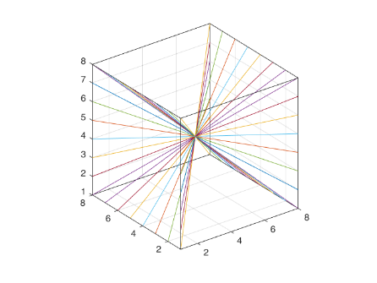
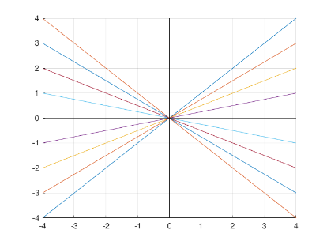
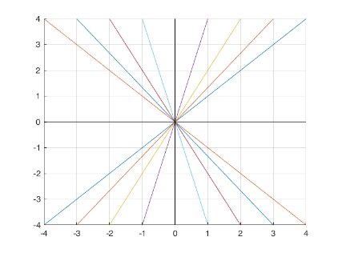
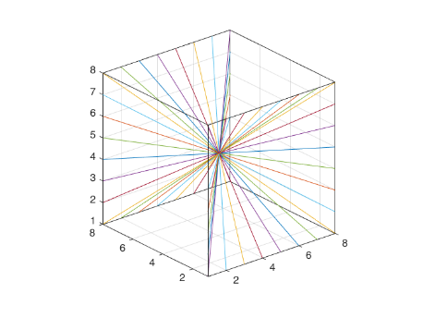
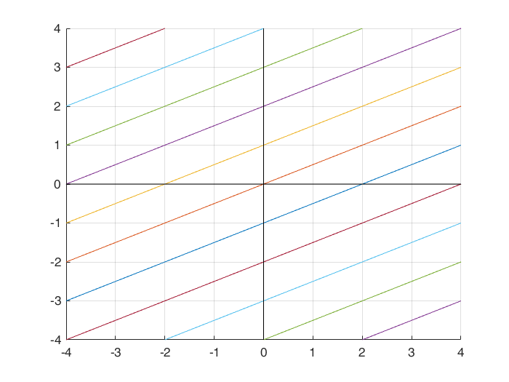
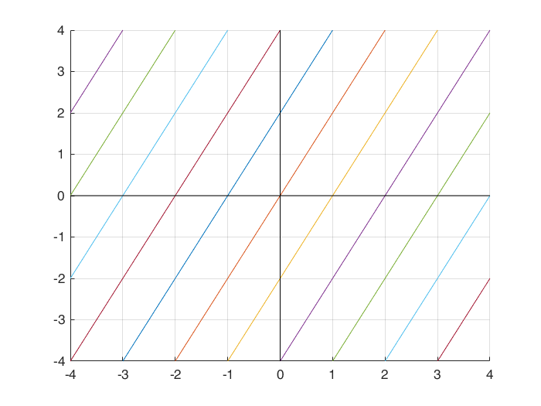
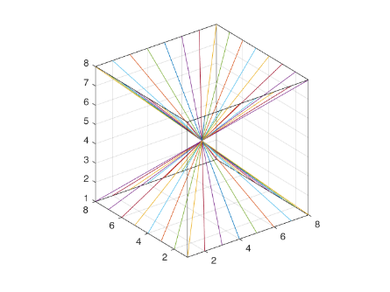
Background
Discrete Parameterization of Line Segments
Slope-Intercept System
Fixed intercept, varying slope
X-driven
X-driven
Y-driven
Y-driven
Fixed slope, varying intercept
Z-driven
X-driven
Y-driven
Notes:
Another aspect is choosing expressive set and parameterization of line segments for line integration
This system of lines corresponds to a family of lines that are equally sampled with respect to their slopes and not with respect to their angles, and the uniform spacing of lines in each projection varies with respect to the slope. This is not the natural choice and might be problematic for reconstruction applications like CT, but for the application of curve detection , it is sufficient.

Slide 11
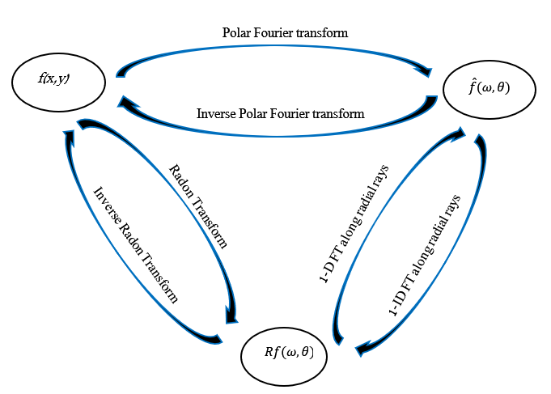
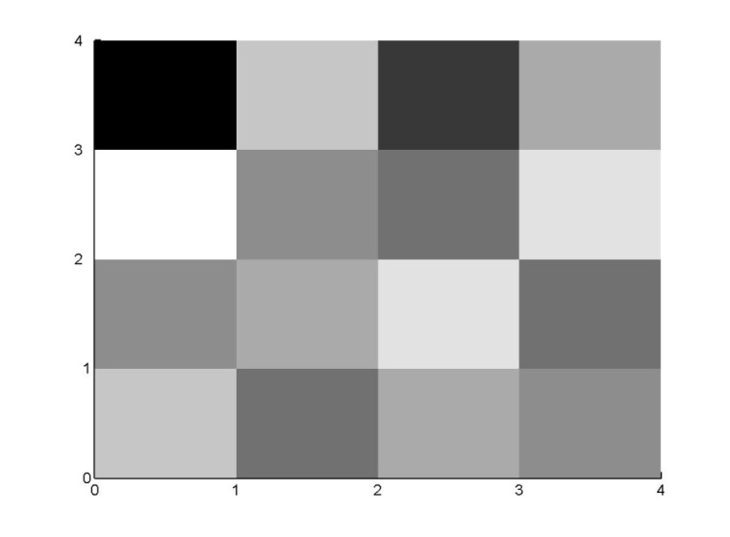
Background
Computation of X-ray
Direct evaluation methods Fourier domain based methods
0
9
1
9
10
5
3
10
6
8
10
3
9
3
8
4
Equivalent to computing integrals over trigonometric interpolation of the sampled image. Tied to slope-intercept system.
Computational Complexity – O(log(N)) per coefficient
Computational Complexity – O(N) per coefficient
Fast Slant Stack (2003), Averbuch et. al.
Notes:
The FSS Algorithm developed by Averbuch et al. [3] computes a discrete 2D Radon Transform. The algorithm is based on the relation between the Radon (X-Ray) transform and the Fourier space, defined by the Projection-Slice Theorem, also known as the Central-Slice Theorem.

Slide 12
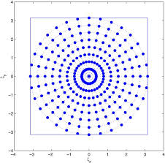
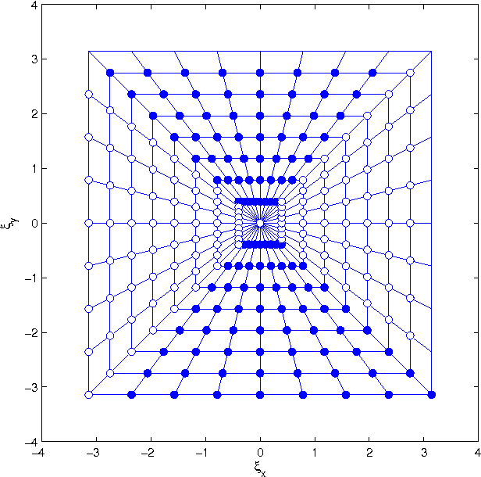
Background
Computation of X-ray
Fourier domain based methods
Polar
Pseudo -Polar
https://www.semanticscholar.org/paper/1-Introduction-1-.-1-Polar-Fourier-Transform-Averbuch-Coifman/7666cfa5840217c65536bf6053268b72b50660c3
Notes:
The projection slice theorem can be used for indirect computation of the radon transform by applying first a polar or polar like Fourier transform following a series of 1D FFT. The main drawback of this approach is that there is no fast and exact polar FFT, and therefore, one needs to compromise either on the computational complexity or the accuracy when computing polar Fourier transform. In order to overcome that, the FSS algorithm uses a fast and exact polar like Fourier Transform called the Pseudo-Polar FFT. The computational complexity of the pseudo polar FFT, (as well as for the entire FSS algorithm), is $O(n^{2}log(n))$. The pseudo polar FFT computes the discrete set of Fourier coefficient over the pseudo polar gride
The pseudo polar grid differs from the polar grid by having concentric squares instead of concentric circles. Another difference is that the pseudo polar grid uses equally spaced slopes instead of equally spaced angles. The FSS transform is performed by applying a series of inverse 1D FFT's along the radial lines of the Pseudo-Polar grid. The resulting discrete set of radon coefficients is identical to the slope-intercept system with respect to the grid in the Radon space
The FSS algorithm can be generalized to 3D in several ways. For comparison and analysis, we used a computational approach that utilizes the operation of 3D shiring . Obviously, it is much easier to compute projection, which is a perfect parallel to one of the axis because than it is no more than a summation of rows or columns. So an effective approach for computing projections is first rotating the image in a way the desired projection becomes parallel to one of the axis. The 3D shiring is similar to 3D rotation and computationally efficient

Slide 13
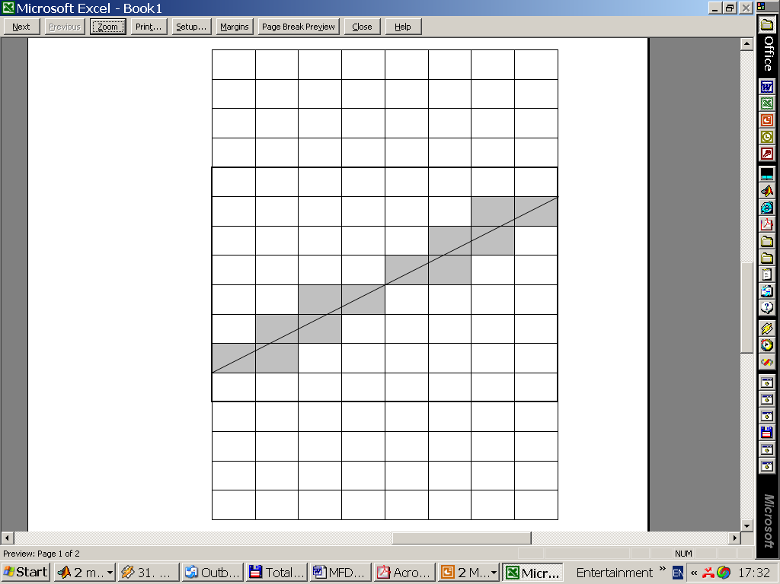
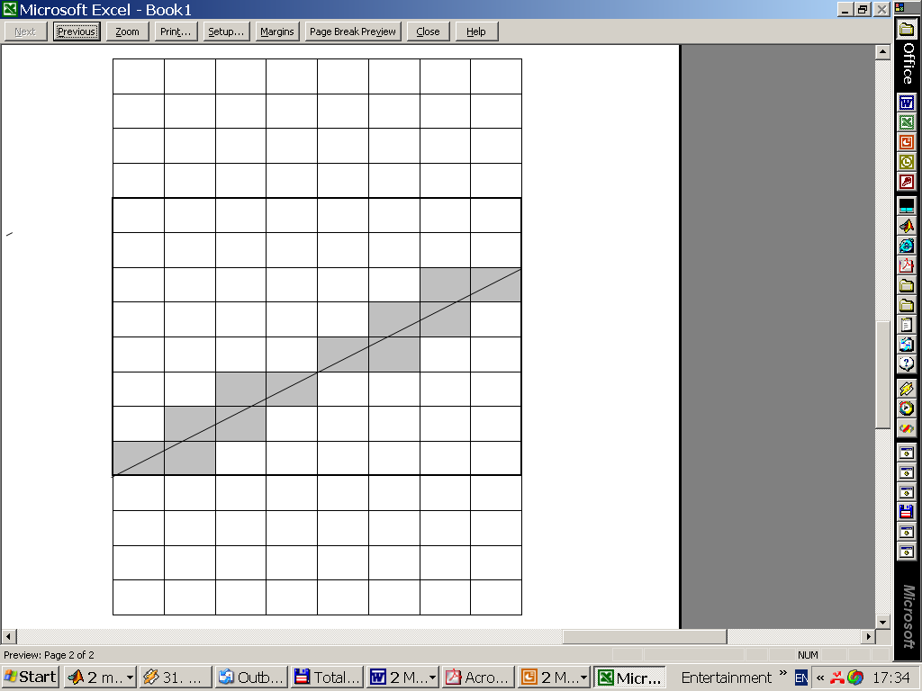
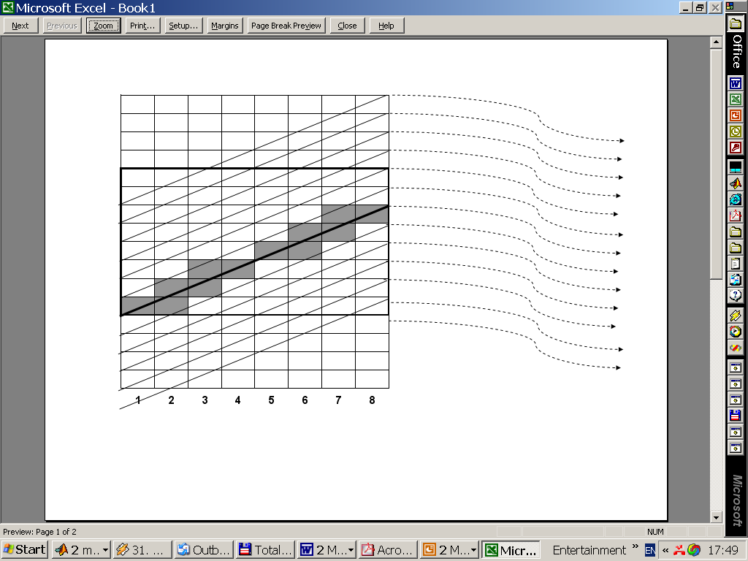
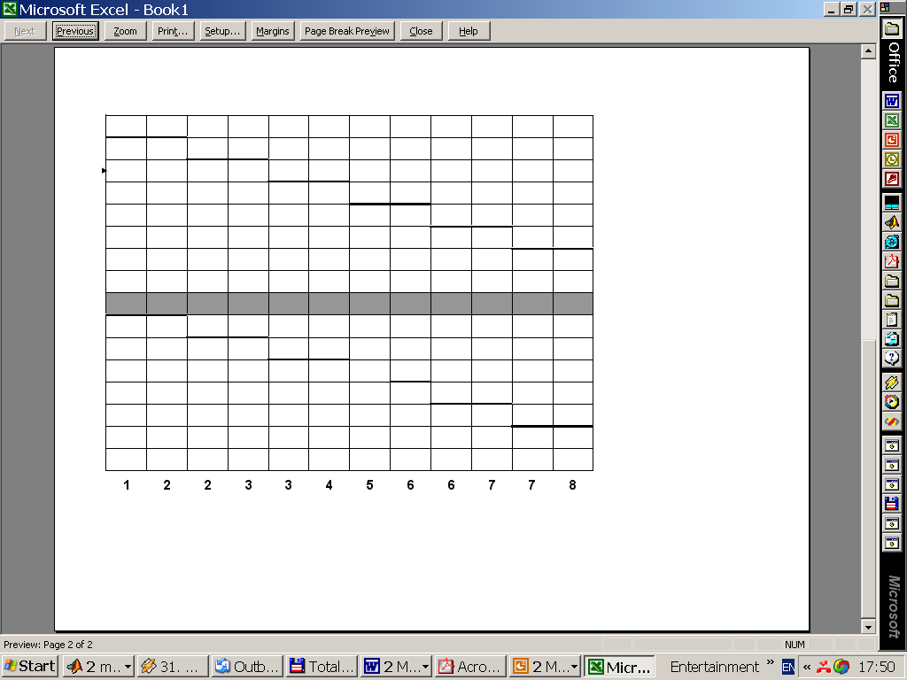
Background
SHAS Algorithm
Observation
Simultaneous calculation with serial memory access
Notes:
I’ll start by demonstrating the main ideas in 2D …
The distribution of weights for line integral is similar for parallel line segments up to appropriate shifts

Slide 14
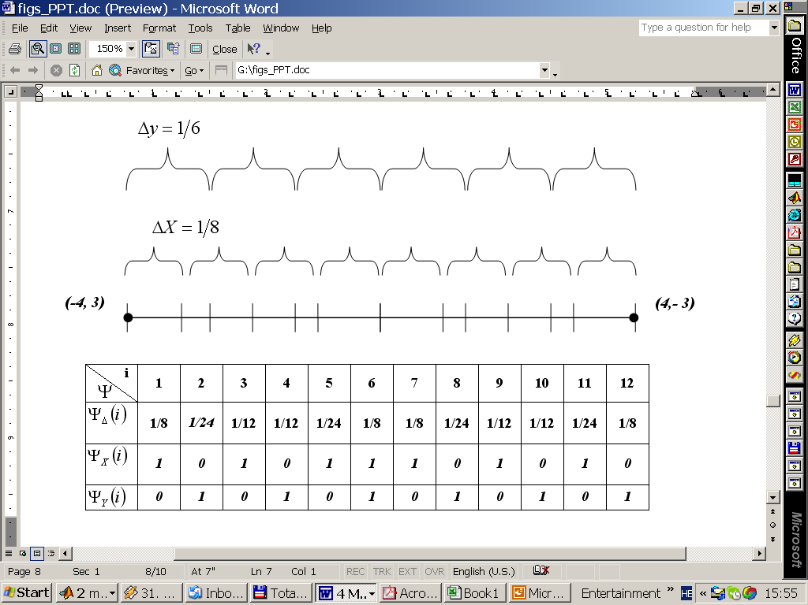
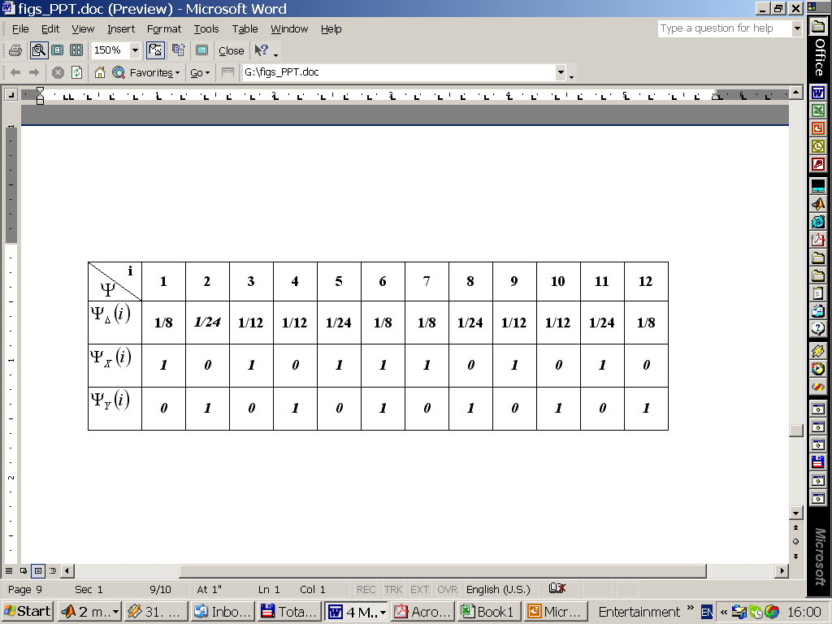
Background
SHAS Algorithm
Merging Series of Grid Intersections 2D
-8 -7 -6 -5 -4 -3 -2 -1 0 1 2 3 4 5 6 7 8
(-4,3)
(-3,3)
(-3,2)
(-2,2)
(-2,1)
-4 -3 -2 -1 0 1 2 3 4

Slide 15
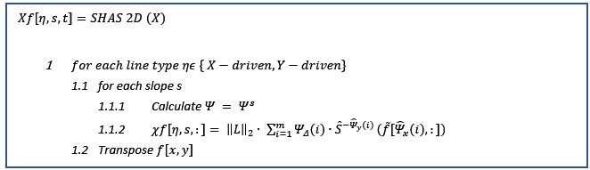
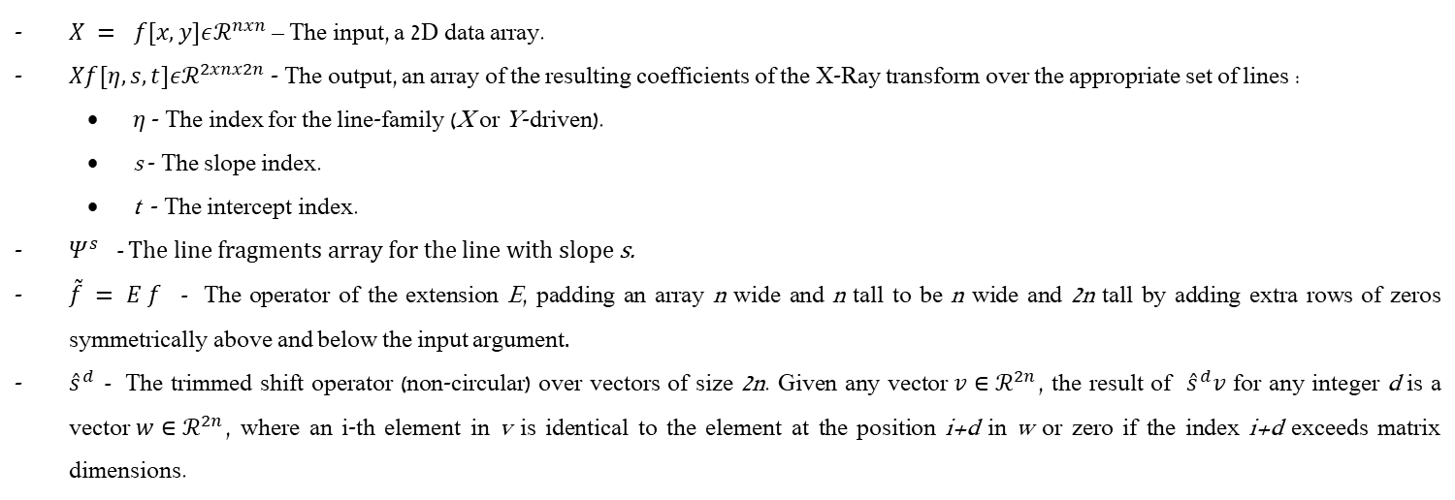
Background
SHAS Algorithm
$X = f[x,y]εℛ^{nxn}$ – The input, a 2D data array.
$Xf[η,s,t]εℛ^{2xnx2n}$ - The output, an array of the resulting coefficients of the X-Ray transform over the appropriate set of lines :
$η$ - The index for the line-family (X or Y-driven).
s - The slope index.
t - The intercept index.
$Ψ^{s}$ - The line fragments array for the line with slope s.
$\tilde{f} = E f$ - The operator of the extension E, padding an array n wide and n tall to be n wide and 2n tall by adding extra rows of zeros symmetrically above and below the input argument.
${\hat{s}}^{d}$ - The trimmed shift operator (non-circular) over vectors of size 2n. Given any vector$v∈ℛ^{2n}$, the result of ${\hat{s}}^{d}v$ for any integer d is a vector$w∈ℛ^{2n}$, where an i-th element in v is identical to the element at the position i+d in w or zero if the index i+d exceeds matrix dimensions.

Slide 16
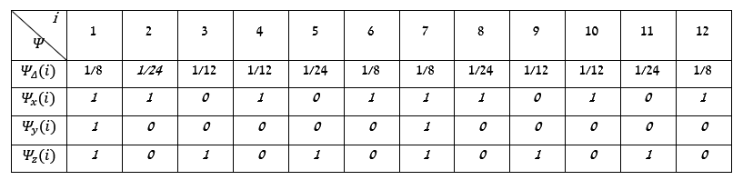
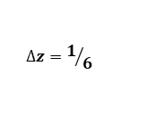
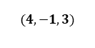
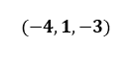
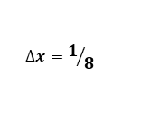
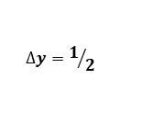
Background
SHAS Algorithm
Merging Series of Grid Intersections 3D
$$∆z=1/6$$
$$∆y=1/2$$
$$∆x=1/8$$
$$(−4,1,−3)$$
$$(4,−1,3)$$
Notes:
The same idea in 3D

Slide 17
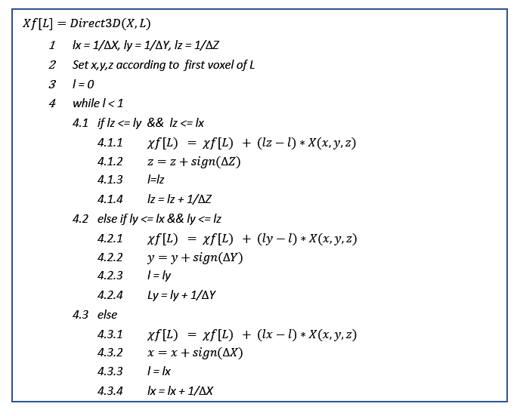
Background
Computation of X-ray
Notes:
merging three equispaced sequences defined by parameterizing the line L using a parameter $0≤ t ≤ 1$ such that L(t) = {x(t),y(t),z(t)} with L(0)=$v_{0}$ and L(1)=$v_{1}$($v_{0},v_{1}$the cube voxels corners, which are the end points of the line segment L). Defining $∆_{x}=x_{1}−x_{0} ,∆_{y}=y_{1}−y_{0} ,∆_{z}=z_{1}−z_{0}$the line segment L intersect a YZ-plane whenever t is a multiple of $1/{\left|∆_{x}\right|}$, an XZ--plane whenever t is a multiple of $1/{\left|∆_{y}\right|}$, and a XY-plane whenever t is a multiple of $1/{\left|∆_{z}\right|}$

Slide 18
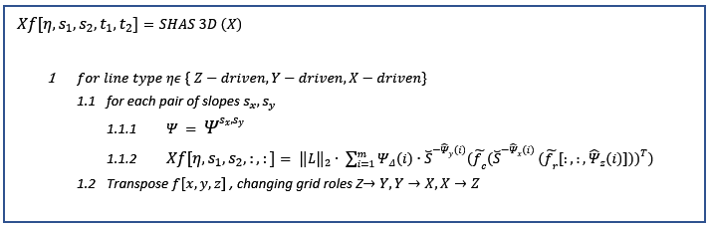

Background
SHAS Algorithm
$− X = f[x,y,z]εℛ^{nxnxn}$ - The Input, a 3D voxel array.
$− Xf[η,s_{1},s_{2},t_{1},t_{2}]εℛ^{3xnxnx2x2n}−$The output, a 5D array of the resulting coefficients of the X-Ray, transforms over the appropriate set of lines:
$η$ – The index for line-family (X, Y or Z-driven)
${ s}_{1},s_{2},t_{1},t_{2}$ - The pair of line slopes and the pair of line intercepts.
$− Ψ^{s_{x},s_{y}}$- The Line fragments array for Z-driven lines with slopes $s_{x},s_{y}$.
$− {\tilde{f}}_{r}= Ef, {\tilde{f}}_{c}= E{f }^{′}$ - The padded matrices of size n, by extra rows or columns of zeros, respectively.
$− {\breve{s}}^{d}$ - The trimmed shift operator (non-circular) over a matrix of size $2n×2n$. Given any matrix$A∈ℛ^{2n×2n}$, the result of ${\hat{s}}^{d}A$ for any integer d is a matrix$B∈ℛ^{2n×2n}$, where an i-th row in A is identical to the row at the position i+d in B or zero if the index i+d exceeds matrix dimensions.

Slide 19






SHAS vs other X-ray approaches
t (sec)
2D
 | Direct Evaluation | Two-Scale Recursive approximations | Fast Slant Stack | SHAS
Accuracy | $${High}^{(1)}$$ | $${Low}^{(3)}$$ | $${High}^{(2)}$$ | $${High}^{(1)}$$
Time Complexity (Per Coefficient) | $$O(n)$$ | $$O(log n)$$ | $O(log n)$ with a high constant factor | $O(n)$ with a low constant factor
Memory Complexity | ${O(n^{2})/O(n^{4}) }^{(4)}$ | $${O(n^{2})/O(n^{4}) }^{(4)}$$ | $${O(n^{2})/O(n^{4}) }^{(4)}$$ | $${O(n^{2})/O(n^{4}) }^{(4)}$$
Memory Access | Not serial | Not serial | Serial | Serial
Line Set Flexibility | High | High | Very Low | Low
Image side size
t (sec)
1 - Exact for Piecewise constant representation of the image.
2 - Exact for representing the image as smoothed trigonometric Interpolation of a sample pixel value.
3 - Relatively Coarse interpolation.
4 - 2D image / 3D image.
3D
Image side size
Notes:
When applying The FSS transformation on an image with a single line, the FSS coefficients are more scattered than for the SHAS ones as there are based on Dirichlet kernel . The difference gets smaller and smaller when n increases. The SHAS is more robust as it includes only simple arithmetic operations like summation and multiplication vs. the FSS, which uses Fourier based interpolation.
Theoretically, the time complexity of the transforms operation per coefficient is O(n) for the SHAS algorithm and $O(log n)$ for the FSS algorithm for a $n×n$ image. However, although the FSS is asymptotically faster, its constant multiplier can be quite significant as it involves the application of the fractional Fourier Transform, which is more expensive than a standard FFT and uses complex arithmetic's. On the other hand, the constant multiplier of the SHAS algorithm is about two and involves summation and multiplication of real numbers. This explains the comparison results seen in the next figures where the SHAS is faster for small-medium image sizes.
The SHAS algorithm allows some flexibility regarding the choice of line set; Unlike the FSS, there are no constraints on the slopes, and any slope density and angular spacing are allowed. The only constraint is on the set of lines, which is limited to subsets of parallel equispaced lines with vertical or horizontal shifts in the 'basically' vertical or horizontal sets. On the other hand, the FSS algorithm is restricted to the pseudo-polar grid, which forces the system of lines to be equispaced with respect to the sloped.

Slide 20

SHAS vs other X-ray approaches
Two Scale Recursion
Notes:
Generally, an approximation of each line segment at the coarse-scale can be made by a connected chain of lines segment in the next finer scale.
the coarse-scale can be computed by summing the appropriate X-Ray coefficients from the next finer scale. Despite its elegant low theoretical complexity and compatibility with the multiscale beamlet structure, the results are not exact (except the case where the coarse-scale line has the same slope as its finer scale parts), and to increase the level of accuracy, one must apply oversampling or accurate and expensive interpolation. The second drawback of this approach is that despite the theoretical $O(\log{n)}$ time complexity per coefficient in practice, the running time is much slower because of the required non-sequential access to the coefficients space, which is much bigger than the image space, especially in higher dimensions

Slide 21
Dynamic SHAS
The 2D Dynamic SHAS
As
Notes:
Scientific area that deals with…..

Slide 22
SHAS vs other X-ray approaches
The 3D X-Ray Transform
As
Notes:
Scientific area that deals with…..

Slide 23

Background
Dim Target Detection
Infrared Images
Point Target
Noise, Background
Presumptions on Target Motion
In Space-Time Coordinates target trace can be seen as filament
Y
T
Notes:
Scientific area that deals with…..

Slide 24


Multiframe Dim Target Detection (MFD)
Detection of man-made dim moving targets by imaging sensors and the estimation of their trajectories
A point target, which can affect up to four pixels in each frame
Low SNR (barely seen by naked eye)
A moving target leaves a signature in the 3D image
Acceleration does not exceed half a picture element per frame. Different kinds of background noise are considered.

Slide 25
SHAS vs other X-ray approaches
The 3D X-Ray Transform
As
Notes:
Scientific area that deals with…..

Slide 26
(SHAS) Motivation: Desired X-Ray Transform Algorithm Performance Measures
Accuracy (with respect to Direct Evaluation and piecewise constant interpolation of digital image)
Speed
Memory access (Sequential/non-sequential )
Flexibility of line sets definition
Notes:
Our opinion about transform algorithm quality based on several measures

Slide 27
(Algorithm) SHAS Algorithm Properties
SHAS algorithm (“SHift And Sum”)
Exact
Fast
Memory-wise economical (Serial Access, “In-Place” calculations)
Flexible with respect to the choice if lines set (Suited for any equispaced lines family)
Easy for Implementation
Easy for Parallel Implementation
Notes:
The name of proposed algorithm is abbreviation of …
The qualities are …

Slide 28
(Performance) Speed
Pentium 4, 2.4GHz, 512Mb
C++ implementation of 3D transform
SHAS algorithm is faster for moderate sizes of input arrays
For Example:
Cube Side: 128
# Coefficients: 3.22E+09
Total Time: 5664 sec (~1.5 hour)
Per Coefficient: 1.76E-06 sec
Notes:
Theoretically O(log n) against O(n) , but in fact algorithm is comparative with FSS up to very high practical data cubes.
Due to serial access, simplicity.
Pentium III , 1Gb speed , 512 Mb RAM, 512 KB CASH

Slide 29





Back Projection Of Various Coefficients
SHAS
Slant Stack

Slide 30
Dynamic SHAS Algorithm (DSHAS) Sliding Window Approach
Dynamic Region of Interest (RIO)
Real-Time Computations
Support: Axis-Parallel Window Transition (left/right/up/down/in/out)
Support: Shrink / Enlarge Window (limited)

Slide 31



DSHAS
Y_{t}
Y_{t+1}
X-Driven Update
v^{out}
v^{in}
A
B
B
Y_{t}
Y_{t+1}
X_{t}
A
w₁
1-w₁
Y-Driven Update

Slide 32

DSHAS: Why Sliding Window ?
Constraints on memory and speed (moderate cube 64³ => 1.5 Gb of coefficients)
Shift-invariant
Dynamic Region of Interest
Fast

Slide 33




Dynamic SHAS Algorithm (DSHAS)
2D Application
3D Application (Related to MFD)
Natural Extension of SHAS algorithm
Optimal run-time (O(1) per coefficient)
Exact

Slide 34
Background
Bcvbcbv
Bcvbcv
Bcvbcb
Bcvcbvc
cbvbcb

